Slide 1



Galileo Progetti Nonprofit Kft. https://galileoprogetti.hu/language/en/home-english/
Hungary - 1016 Budapest, Aladár utca 6. fszt./1.
+36 70 323 38 35

Slide 2
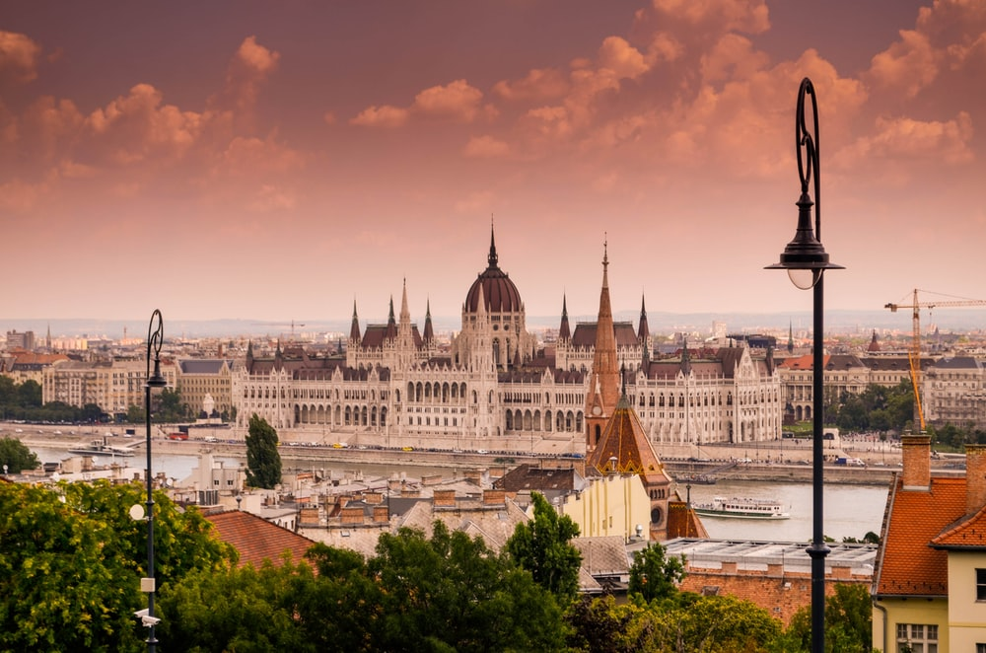

  Based in Budapest, Hungary, Galileo Progetti
  was founded in 2009
  by Hungarian partners and by ARCA Cooperativa Sociale, Florence, Italy.
  Why the name “GALILEO” ?
  …Take a guess!
Our Story

Slide 3

“Eppur si muove -
And yet it moves”
"And yet it moves“ is a phrase attributed to the Italian physicist and philosopher Galileo Galilei after being forced to recant his claims that the Earth moves around the Sun, rather than the converse.

Slide 4


“Eppur si muove-
And yet it moves”
In our context, we want to affirm the principle that we do not give up in face of possible difficulties, and we continue to promote our ideals of a more inclusive, equitable, ever-moving society!

Slide 5

Our mission
  Through its activities, GALILEO aims to contribute to...
  • a sustainable development and growth
  • to strengthen social inclusion and
  social economy in Hungary
  • promoting the sensitization of professionals and society, sharing good practices and disseminating models and tools
  • increase the European dimension,
  and strength the European Networking
  and cooperation

Slide 6
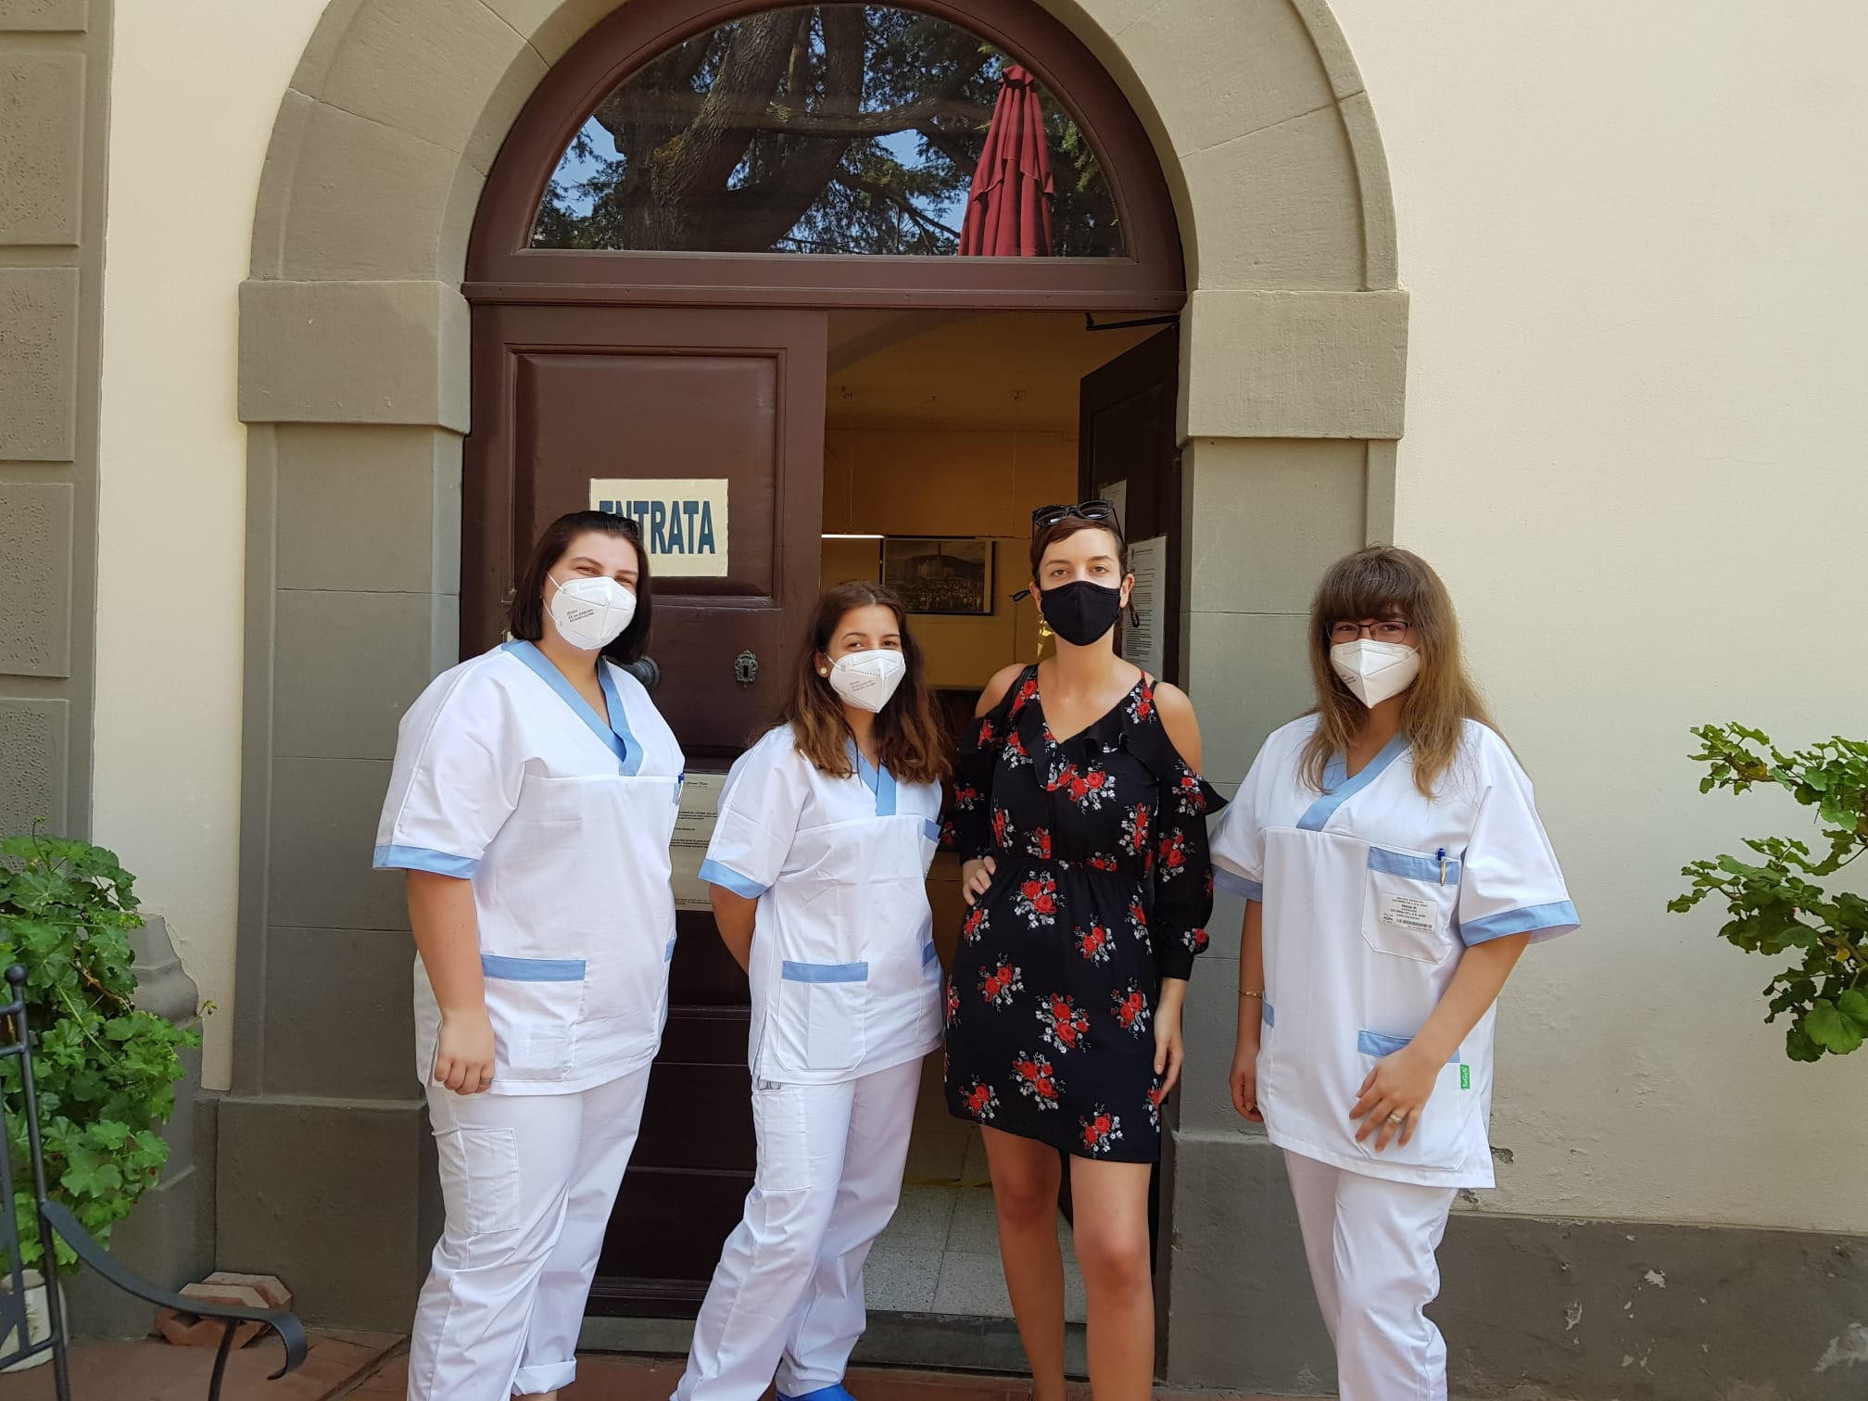
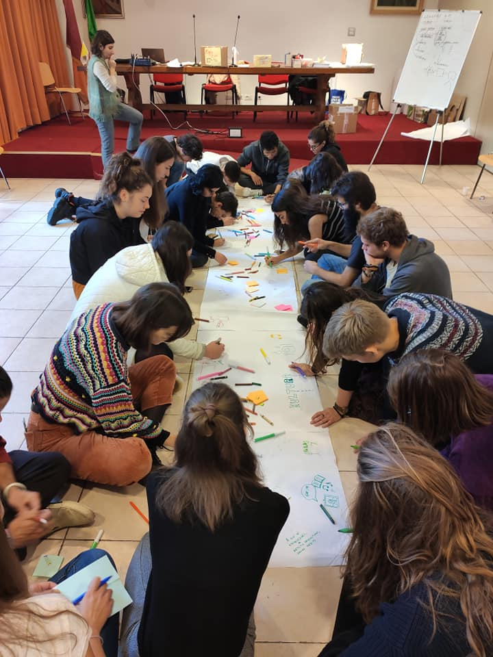
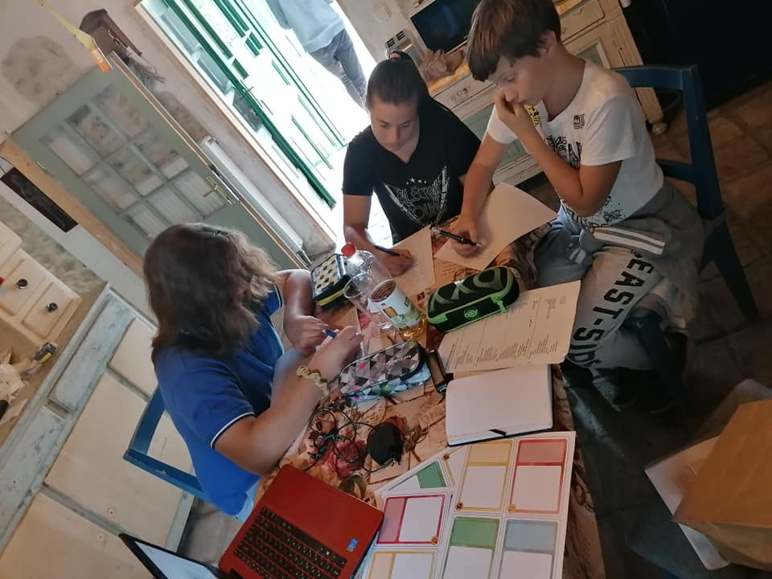
Our main topics
Social inclusion,
Employment,
Equal opportunities,
Inclusive and intercultural education,
Improvement of ECEC quality
Fighting poverty, exclusion and discrimination,
Full citizenship.

Slide 7
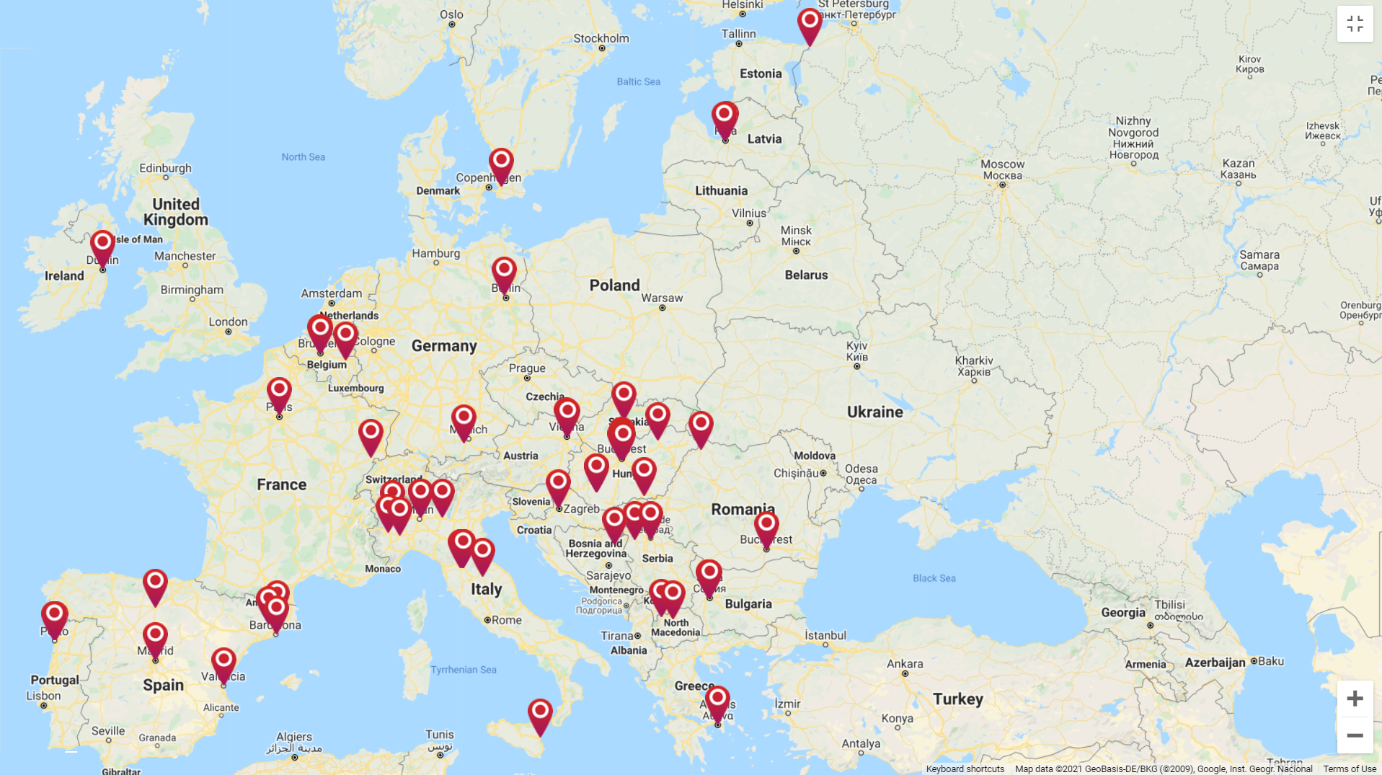
Our network includes
  GALILEO is a big, big fan of networking. We work with several organizations, as:
  Social economy organizations
  Pre-school providers
  Schools
  VET provider
  High level education institutions-Universities
  Public institutions, decision makers as municipality, ministry etc.
  Civil associations, non-profit organizations and foundations
  Research institutions

Slide 8
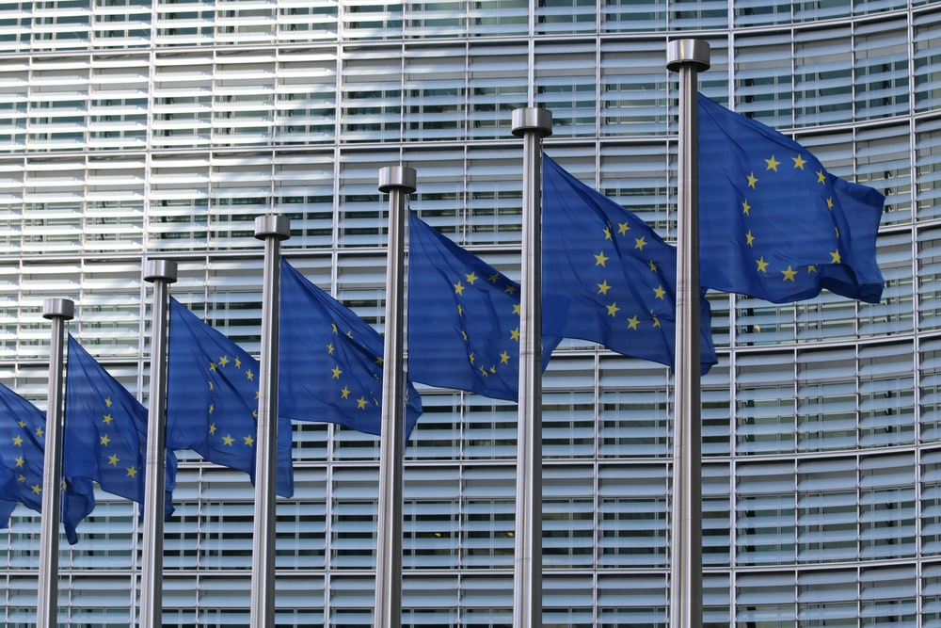


Galileo Progetti in European Projects
  Galileo Progetti has numerous experiences in European project, as promoter, coordinator and partner, in different lines:
  • Erasmus+ (KA1, KA2 Strategic • Partnerships, KA3, Traineeship, EVS, ESC);
  • CEI Central European Initiative;
  • Progress;
  • Europe for Citizens.
  • Leonardo da Vinci (Mobility, • Partnership, Transfer of Innovation);
  • Horizon 2020 (we are beginner!)
  More information about our projects is available on our web site
  http://www.galileoprogetti.hu/projects.html

Slide 9

    Claudia Piovano,
    CEO, general coordinator
    and project manager
    Ádám Fekete,
    Financial Responsible

Slide 10


Be Unit is a young-centered project, co-financed by the Erasmus+ programme, that wants to involve 45 young people – aged between 18 and 25 years old – in the design and organisation of an International Festival of Short Films. At the same time, the audiovisual language will become a useful tool for initiating an action of youth advocacy, intended as a form of activism aimed at bringing the voices, needs, and ideas of the new generations to the attention of local, national, and European institutions.

Slide 11


Enhancing Roma youth work
Roma Volkshochschule Burgenland, Austria
Galileo Progetti, Hungary
CARITAS BOLZANO BRESSANONE, Italy
Asociatia “Pe bune”, Romania
Objectives: to establish a transnational network of youth and social workers working with the Roma community. With significant involvement of Roma youth, the project aims to promote capacity building, cooperation and exchange of different perspectives, experiences and approaches, and to formulate targeted solutions. This will enhance the capacity of Roma youth as well as youth and social workers to improve the situation.
Implementation: survey among Roma youth to get an overview of their wishes and concerns, workshop to sharing of results between European youth and social workers, publishing of the results and recommendations in a manual.
Results: strengthen capacity and sensitivity to the needs of Roma youth of organization, development of new methods and tools, resulting in a manual with "best practices" and concrete recommendations for policy makers and stakeholders, network of cooperation.

Slide 12
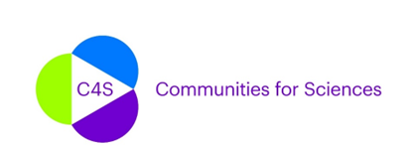

Work with vulnerable communities by fostering science education in children and youths aged from 0-16 years old, and their families, through formal and non-formal pedagogical institutions.
Raise awareness at an institutional level (policy-makers, museum representatives, schools, associations, etc.), of some value-laden practices in science education activities and provide tools to redress such practices.
Promote engagement in inclusive science education through the creation of working groups with scientists or science-related members of those vulnerable communities co-participating in different programmes to foster inclusive science education.
The Communities for Sciences (C4S) CONSORTIUM is integrated by Fundació Universitària del Bages (Manresa campus of UVic-UCC) and Vic campus of UVic-UCC (both from Catalonia-Spain), IB University of Applied Health and Social Science (Germany), Galileo Progetti (Hungary), Universita’Degli Studi Di Milano-Biccocca (Italy), Board of Education for Vienna, European Office (Austria), Municipality of Sesto San Giovanni – Socio Educational Sector – GiocheriaLaboratori (Italy), Erasmus Brussel University of Applied Sciences and Arts (Belgium), Wirtschaftsuniversitat Wien (Austria), Lunds Universitet (Sweden) and New Bulgarian University (Bulgaria).

Slide 13


NET-WORKS 2020 project consented to establish new national and regional networks of work-based adult education providers, providing them with tools to strengthen their ability to provide effective adult education – especially for those furthest from the labour market.
ERASMUS+ PROGRAMME KA3: Support for policy reforms

Slide 14

ART & INCLUSION project target groups are adults with disability and adults with mental illness, who tend to have less participation in adult education, formal or non-formal, in lifelong learning activities and in the labour market.
– Promote the social inclusion of adults with disabilities and mental illness, through the capacity building of professionals and organizations working in this field. ART & INCLUSION project target groups are adults with disability and adults with mental illness, who tend to have less participation in adult education, formal or non-formal, in lifelong learning activities and in the labour market.
– Promote the production of knowledge in the context of the use of artistic methodologies in non-formal education as an adjunct to the construction of the individual life project of people with disabilities and mental illness.
– Promote the exchange of good practices among professionals, aiming its transnational replication.
– Contribute to the development of innovative practices in adult education, namely non-formal education throughout art.

Slide 15


Training courses for professionals to acquire the skills necessary for a positive engagement with the target public - people far away from employment - and to facilitate their socio-professional integration;
Transferable know-how materials between the different countries involved and in other non-project countries;
Digital tools to increase the cooperation between training and socio-professional actors.

Slide 16
Galileo Progetti Nonprofit Kft. www.galileoprogetti.hu
THANK YOU!
H-1126 Budapest, Böszörményi út 2/a
+36 70 323 38 35

